Slide 1
Customer loyalty is strong;
subscription conversion is the gap
Customer shopping behavior

Slide 2

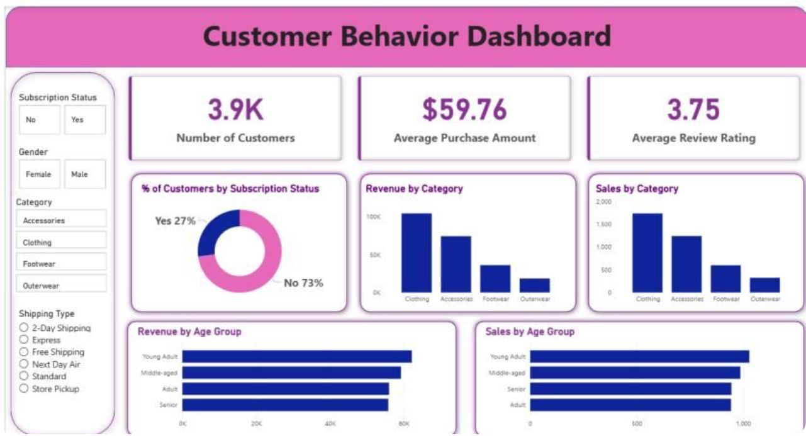
DATASET
3,900 purchases reveal a broad, repeat-driven customer base
3,900 purchases
Across 25 products, 4 categories, and 50 locations
$59.76 average purchase
Average review rating: 3.75
37 ratings imputed
Missing review ratings were imputed by product-category median
Source dashboard
SQL-ready database
The cleaned data was loaded into MS SQL Server for SQL analysis
02

Slide 3
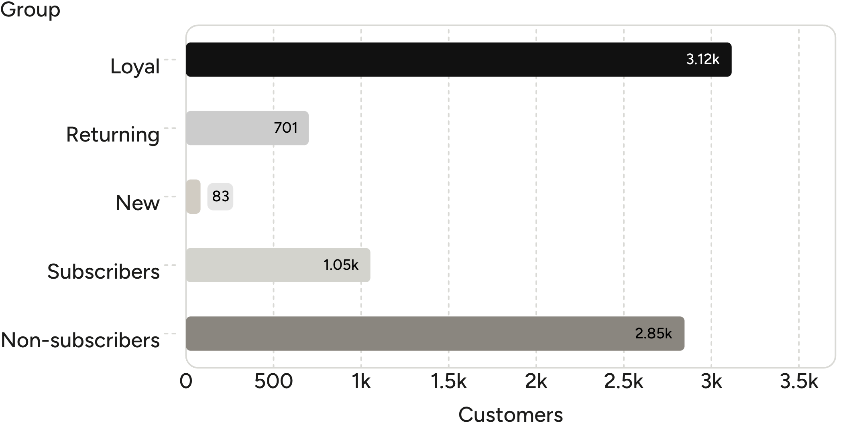
CUSTOMER BASE
Loyal customers outnumber subscribers by nearly 3 to 1
Adoption remains the minority behavior
Loyal: 3,116 customers; returning: 701; new: 83.
Subscribers: 1,053 customers, versus 2,847 non-subscribers.
Revenue: subscribers contributed $62,645; non-subscribers contributed $170,436.
Customer segments and subscription status
03

Slide 4
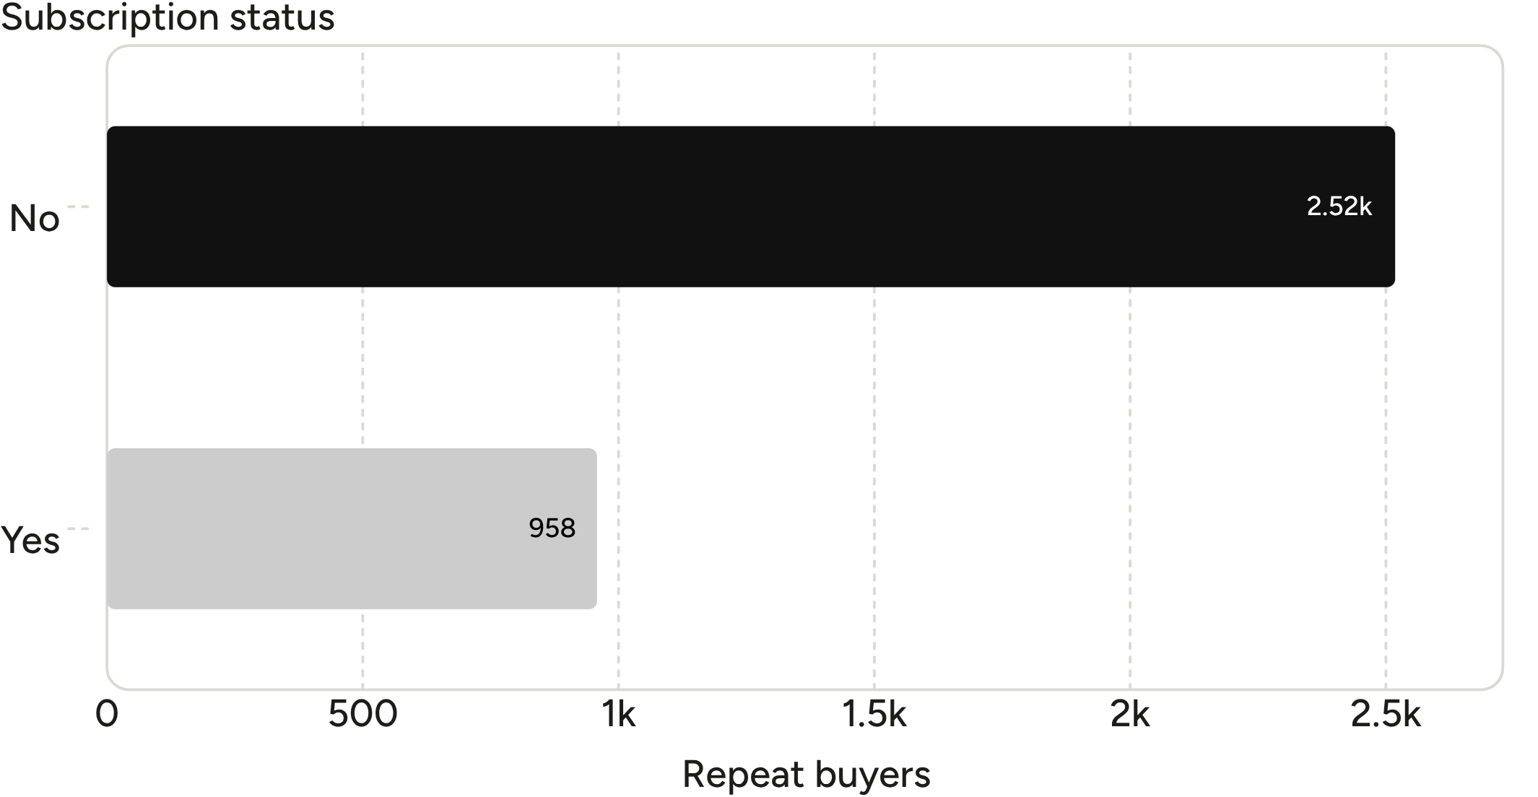
GROWTH LEVER
The next growth lever is converting repeat buyers, not finding more first-time buyers
Most repeat buyers are still outside the subscription program.
Repeat buyers: 958 subscribers and 2,518 non-subscribers.
Use loyalty signals and purchase history to target subscription offers.
Repeat buyers by subscription status
04

Slide 5
REVENUE MIX
Revenue is distributed across age groups, with young adults slightly ahead
Revenue by age group
Young Adult
Middle-aged
$62,143
$59,197
GENDER REVENUE
$157,890
Male customers generated $157,890 versus $75,191 from female customers.
Adult
Senior
$55,978
$55,763
05

Slide 6
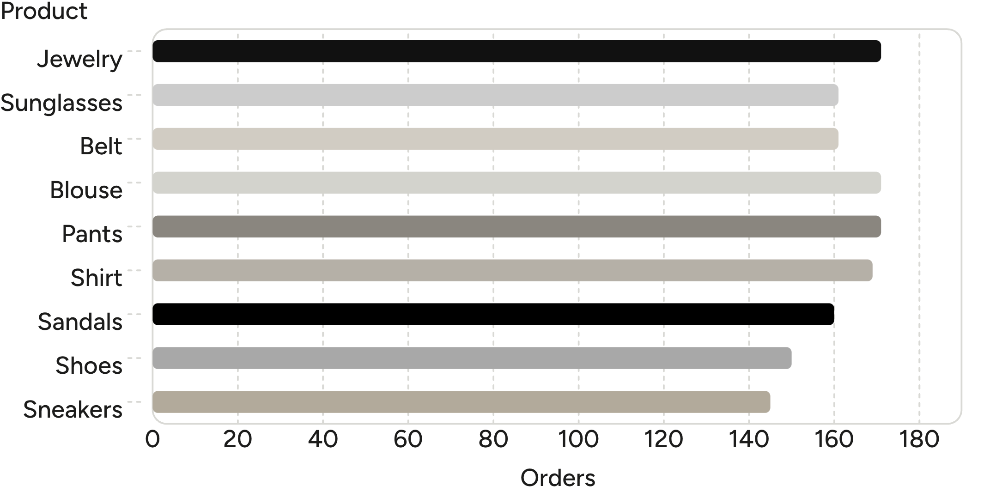
PRODUCT DEMAND
Accessories lead demand, while footwear creates a strong product story
Lead with demand, then add proof
Accessories: Jewelry 171 orders; Sunglasses 161; Belt 161.
Clothing: Blouse 171; Pants 171; Shirt 169.
Footwear: Sandals 160; Shoes 150; Sneakers 145.
Highest-rated: Gloves 3.86; Sandals 3.84; Boots 3.82.
Top products by orders
06

Slide 7
DISCOUNT EXPOSURE
Discounts are common in several categories, but not all discounts are equal
Product | Discount rate
Hat | 50.00%
Sneakers | 49.66%
Coat | 49.07%
Sweater | 48.17%
Pants | 47.37%
839
Customers spent above the average purchase amount while using discounts.
Separate margin-protecting offers from blanket discounting.
Products with the highest discount rates
07

Slide 8
VALUE SIGNAL
Shipping speed is a small but visible value signal
Average purchase
$60.48
Review rating: 3.75
Express shipping
Average rating across the dataset.
Standard shipping
Test express-shipping messaging
$58.46
Position it as a premium benefit alongside subscription offers.
Express leads by $2.02.
08

Slide 9
DECISION AGENDA
Three moves can turn shopping behavior into growth
01.
Convert repeat buyers
Target the 2,518 repeat buyers outside subscriptions with exclusive benefits.
02.
Protect margin
Review discount-heavy products and focus promotions where high spend persists.
03.
Prioritize demand
Feature top-rated products, lead with accessories and footwear, and tailor campaigns by age group and shipping preference.
Use the dashboard to track subscription conversion, repeat-buyer movement, discount exposure, and category revenue over time.
09

